Slide 1
Data Science Capstone Project – Restaurant pipe Dream
Lauren Crowe

Slide 2
Problem Statement:
I have always desired to open a NY Deli and Sandwich shop, as I grew up waitressing in one. I loved the people and the atmosphere. North Carolina is overrun with chain deli shops like Jimmy Johns, Jersey Mike’s, etc. so I would like to find a location close to family where a small business would thrive without excess competition.
I am from Greensboro, NC and have the option of opening this shop in Charlotte (where I currently live) or Greensboro NC.
Since this decision would require a substantial financial input on my part I need to determine which city and neighborhood within the city selected has reasonable rent costs. Once I select a city, I want to understand which areas of the city have the most Deli/Sandwich shops so that I can select an area that doesn't have an oversaturated market.
Even though this is a pipe dream of mine, anyone who is interested in opening a restaurant would benefit in leveraging Data Science to make an educated decision before selecting a location to open any restaurant or venue.

Slide 3
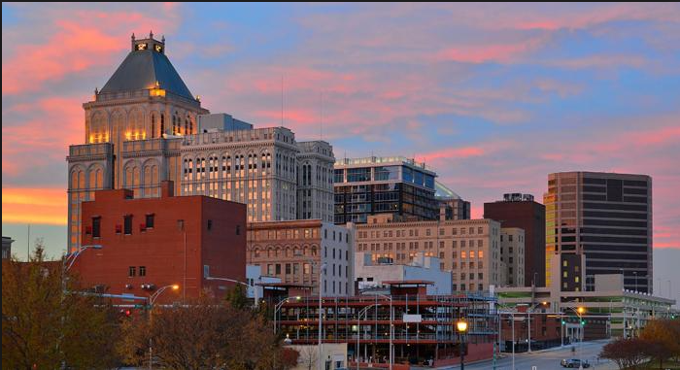
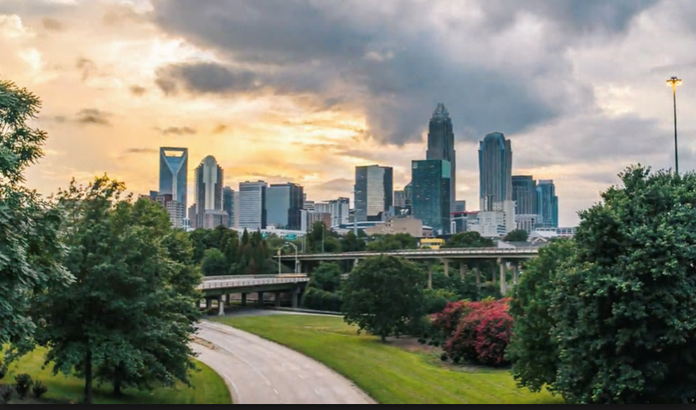
Data Leveraged:
Several data sources were leveraged for this analysis. First I used data researched on the web of the “Top 50 Zip Codes in NC for Rent Cost” to determine if there were area’s of Charlotte or Greensboro NC that had higher rent costs than I could afford as a new small business owner. After determining which of the two cities has more reasonable rental space costs I leveraged zip code geospatial data to obtain all the zip code coordinates for the state of NC. This geospatial data was an input into my zip/neighborhood Foursquare venue analysis to determine the most common venues for each zip code. Ultimately, these sources allowed me to determine a restaurant location that was budget-friendly and a ripe location that would bring in new customers without extreme competition.
Or?

Slide 4
Methodology:
Main components of report, discuss exploratory data analysis, inferential statss, what machine learning techniques used.

Slide 5
Results:
Discuss results from analysis.

Slide 6
Discussion:
Discuss observations noted and any recommendations you can make based on results.

Slide 7
Conclusions:
Discuss observiation noted and any recommendations you can make based on results.

Slide 8
References

